Slide 1
Meet the Teacher...
Year 4

Slide 2
Class Organisation
Year 4 team
4S
Teacher – Mrs Smallwood
LSA – Mrs Evans
4B
Teachers – Mr Brewster
LSA – Mrs Evans
Mrs O’Sullivan will also be working with Year 4
PPA – Tuesday afternoons (Madam Miller – French/Mrs Windram – Music)

Slide 3
Home Learning...
Reading
Recorded in the Reading Diary, at least 4 times per week with HP rewards. Parents must sign/initial their child’s reading records at the end of each week.
Library – We have 2 opportunities each week to visit the library. This will be on Tuesdays and Fridays. The library will not be open before or after school at the moment.
Maths
A piece of maths homework will be set on alternate Fridays. This may be in the form of a paper copy or online using www.mymaths.co.uk. Alternatively we may use google classroom. Your child should already have the login from last year. If your child doesn't have internet access at home, please let us know. Homework is due in on the following Wednesday.
All children are expected to know their multiplication tables to 12x12 by the end of Y4. Your children will be taking a new Times Tables test at the end of the year. TTrockstars will be used A LOT!
English
An English task will be set on alternate Fridays and is due in on the following Wednesday. English tasks will take the form of spelling investigations and grammar and vocabulary work via google classroom. We will not be setting spellings for homework as we teach 3 x spelling sessions each week during class time.
Handwriting homework
Children will work towards their pen permit. They need to demonstrate a fluent, joined style. We will be setting handwriting homework for those children who need to practise.
.
.
Notes:
APP useful

Slide 4
Rewards...
Verbal praise
Superstars – children move from the ‘Great’ board to the ‘Superstar’ board. They receive a sticker at the end of the day.
BEST learner – awarded to the child who has demonstrated BEST qualities. They will receive 3 house points.
House Points – given by any member of staff for good learning, behaviour, effort or achievement.
Outstanding certificates are awarded for exceptional learning or effort and presented by Mr Dodson on a Friday afternoon.
Celebration Assembly – showing an outstanding piece of work, kindness or effort that exemplifies ‘Be the Best You Can Be’. This takes the form of a weekly celebration assembly which we will record and post on your child’s google classroom stream.

Slide 5
Reminders...
Reading Diaries
need to be in school every day.
filled in as and when you read.
will be checked in class on a Friday.
PE kit
full kit is needed in school every day
4S and 4B : Outdoor games: Thursday , Indoor PE: Wednesday
Children should keep their PE kits in school and will change for the lesson. Due to health and safety regulations earrings must be taken out or covered during P.E lessons. If your child cannot remove their earrings, please ensure they do not wear them on P.E days or supply them with plasters or tape to cover them. If your child has long hair, please ensure it is tied up for PE.
Uniform
guidelines on website, send a note if haven’t got the correct kit.
Please mark all belongings clearly.
We want children to look smart and be safe – no wrist bands or jewellery please (watches and stud earrings may be worn)

Slide 6
Reminders...
Health
We have children in school with severe allergies – please don’t include food with nuts for snacks or packed lunches.
Fruit or vegetable snacks only can be brought for morning break time.
Bags
Children may opt for a small rucksack rather than a book bag.
Pencil cases
Must be taken home or stored in their trays at the end of each day.
Water bottles
Please provide your child with a named water bottle that is refilled each day.

Slide 7
Year 4 Curriculum
Tomb Raiders: Ancient Egypt
India
Romans
Italy
Saxons
Super Humans: The Human Body
Termly newsletters will be sent out with more detail
*

Slide 8
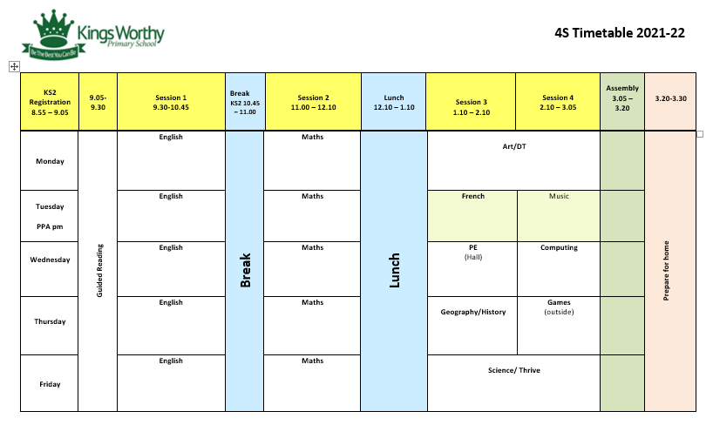

Slide 9
Any questions?
Please come and talk to us, or write a note, if you have any concerns or questions…

