Slide 1

Meet the Teacher
Year 5
2024-25

Slide 2

Teaching...
Year 5 team
Teachers | 5S – Mrs Smallwood, Mrs Clarke 5W - Mrs Williamson
LSAs Throughout Year 5 | Mrs Harkay
PPA Cover - Wednesday | Mr Watton (PE) Mdm. Miller (French)
5W Wednesday mornings | Mrs Anning

Slide 3
Learning...
We will be covering the following topics throughout Year 5:
Vikings
Space and Sweden
Sustainability in Kings Worthy
Ancient Civilisations – Shang Dynasty
Ancient Maya
Brazil

Slide 4
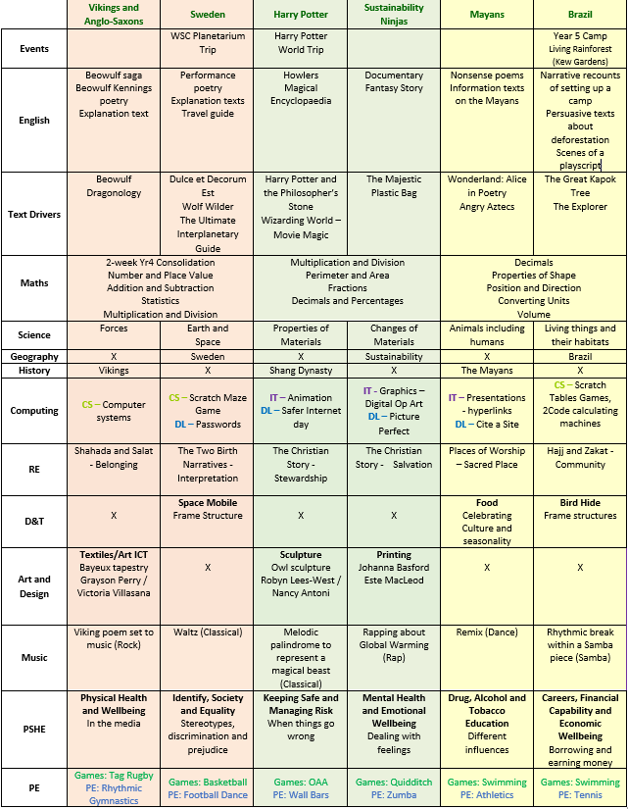
Learning...
Our curriculum map will also be uploaded on our website pages so you are able to see what we will be covering in different units throughout the year.

Slide 5
Other opportunities...
We are very much looking forward to organising some exciting learning opportunities outside of school this year!
Autumn – Residential 2nd-4th October
Remembrance Service - 8th November
Spring – Harry Potter Studios (Wednesday 5th February 2025)
Summer – Swimming Lessons
Kings Worthy Production
More details about any trips or events will be sent out via email closer to the time.

Slide 6
Parent contributions...
We are aware that our cost of living is rising, and some may wish to plan in some of our trips and events with estimated costings for this year:
Harry Potter Studios (February) - £35.00
Swimming (Summer Term) - £35.00
Please come and speak to us if you have any questions about these costings. They are estimations, and could change.

Slide 7
Homework...
Maths/English homework – Google Classroom (paper copies given)
Maths homework will focus on consolidation or revision of a subject we have covered in Year 4 or 5.
English homework will be consolidating an area studied in class (spelling or grammar), including spelling shed.
Ed Shed logins allow access to Maths Shed and Spelling Shed.
Homework is set on a Friday and due in the following Wednesday.
Reading
Recorded in the reading diary at least 4 times per week. When 4 entries are written in, children will have an ‘S’ recorded and will indicate 3 house points.
Please ensure to initial children’s entries.
These will be collected by class teachers on a Friday.
Reading diaries should be brought into school every day.
Library days will be Friday and Tuesday.

Slide 8
Additional Home Activities...
Login information can be found in the back of children’s reading diaries for the following websites:
Purple Mash
Times Table Rock Stars
Ed Shed:
  Spelling Shed
  Maths Shed
There are a range of games and challenges that children can explore at home in addition to set homework.

Slide 9
Rewards...
House Points – given by any member of staff for effort or achievement. Codes at the bottom of their work mean house points have been awarded.
Best Learner – One child who has stood out for excellent learning behaviours throughout the day will be awarded ‘best learner’. A special sticker is awarded and 3 house points..
Celebration Assembly – showing an outstanding piece of work, kindness or effort that exemplifies Respect, Responsibility and Resilience. This is an in person assembly, by invitation only, on a Friday afternoon.
Outstanding Certificates – When children have completed a piece of work that is to an ‘outstanding level’ for them, we will award an outstanding certificate. It will be signposted in their books and Mr Dodson will come into the classroom and present the certificates to the children on a Friday afternoon.

Slide 10
Reminders...
PE
PE days – Wednesday and Thursday
Children will need to come into school dressed in their PE kit on these days.
Trainers need to be kept in their locker so that they can change into these when necessary.
Water bottles
Please ensure your child has a named water bottle in school every day.
Uniform
Guidelines on our website, please send a note or speak to us on the door if they haven’t got the correct uniform. Please mark all belongings clearly.

Slide 11
Reminders...
Collection Arrangements
Please ensure you have spoken to the class teacher or emailed the admin office if your child is going home with a different adult. Additionally, if you would like your child to walk home, please update the consent on Arbor.
Medical
We have children in school with severe allergies – please don’t include food with nuts and sesame for snacks or packed lunches, or send food items on birthdays.
A healthy snack can be brought for morning break time.

Slide 12
Any questions?

